Slide 1
Fuego Test Automation Framework
Sahithi S

Slide 2
Project Introduction
Fuego is the official automated test framework for the LTSI project.
It was formerly called "JTA" (for Jenkins-based Test Automation), but the name was changed in March 2016 for branding purposes.
The quick introduction to Fuego is that it consists of a host/target script engine, with a Jenkins front-end, and over 50 pre-packaged tests, deployed in a docker container.

Slide 3
Fuego Configuration
The overview of the steps is:
1. Install pre-requisite software
2. download the fuego repository
3. build your fuego container
4. start the container
5. access the interface
6. add your board to fuego
7. run a test
sudo apt-get install git
sudo apt-get install docker.io

Slide 4
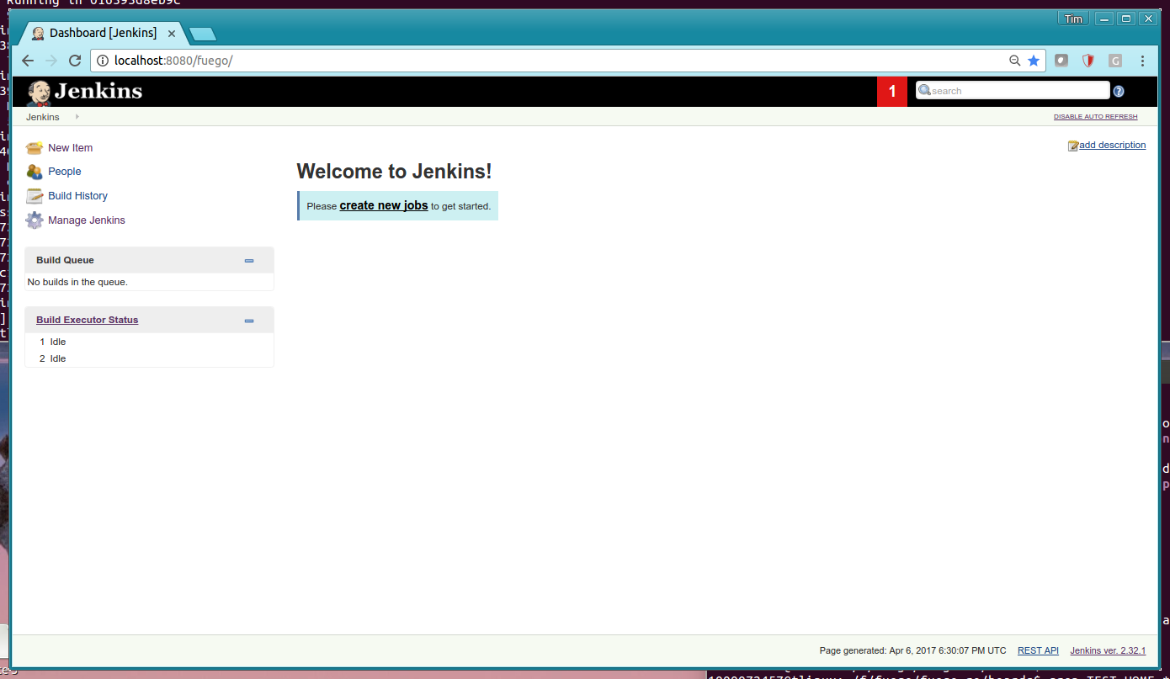
Fuego-Clone, Build ,Start and Access
git clone https://bitbucket.org/tbird20d/fuego.git
git clone https://bitbucket.org/tbird20d/fuego-core.git
cd fuego ; ./install.sh
fuego-host-scripts/docker-create-container.sh
fuego-host-scripts/docker-start-container.sh
firefox http://localhost:8080/fuego

Slide 5
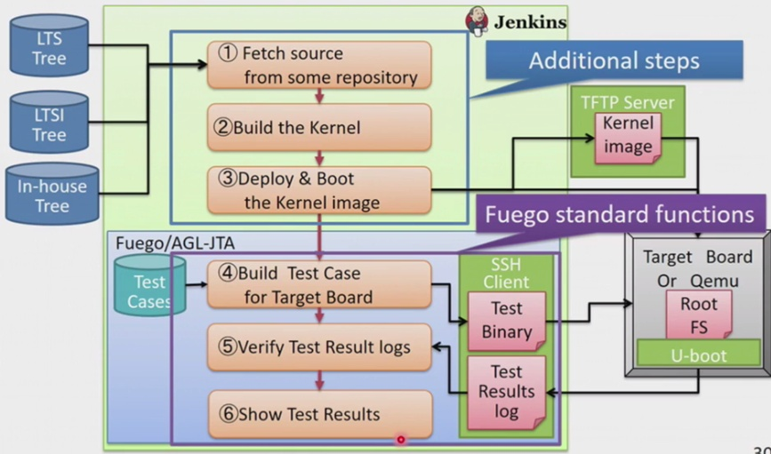
Archiecture Diagram

Slide 6
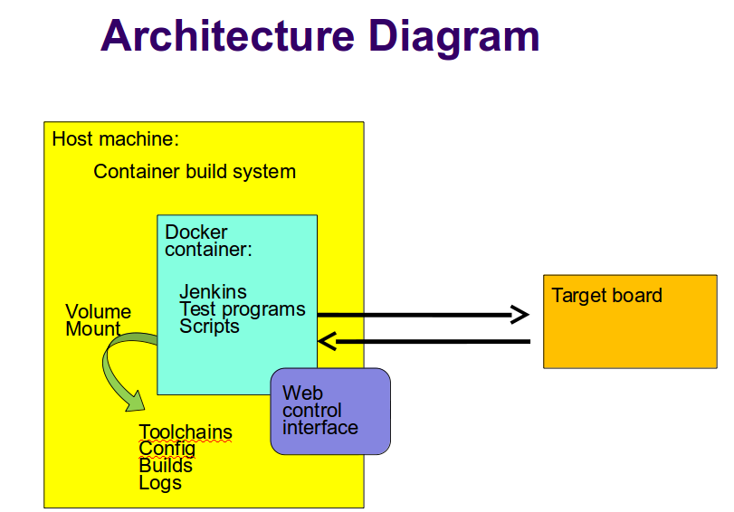
Fuego Architecture

Slide 7
Docker
Docker is container management services.
Docker provide facility to run an application in isolated env which
is called container
We can run many containers simultaneously on given host.
Its used less memory, its secure by default because each container
isolated from another
Docker = Build , Ship and Run Any App , Anywhere

Slide 8
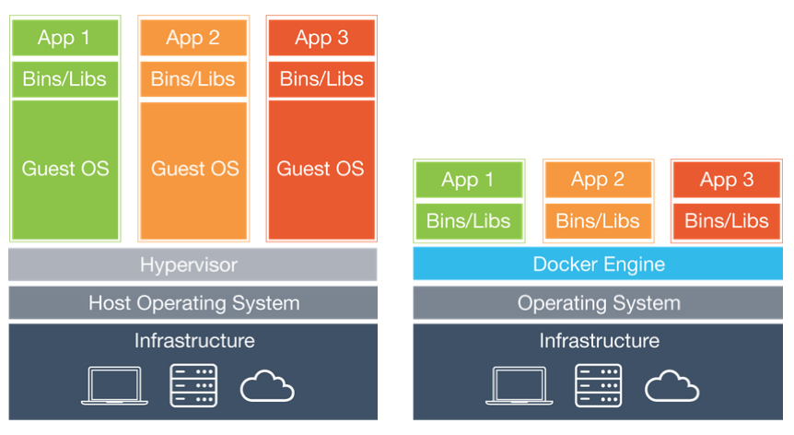
Docker Vs VMware
docker ps -a
docker search ubuntu
docker pull ubuntu:14.04
docker images
docker run -i -t ad892dd21d60 /bin/bash
docker commit 3a09b2588478 ubuntu:14.04

Slide 9
By default, Fuego runs inside a Docker container. This provides two benefits:
It makes it easy to run the system on a variety of different Linux distribution
It makes the build environment for the test programs consistent

Slide 10
Thank You

